Slide 1
Case Overview Dashboard
File created on: 6/5/24 4:43:50 PM PDT

Slide 2
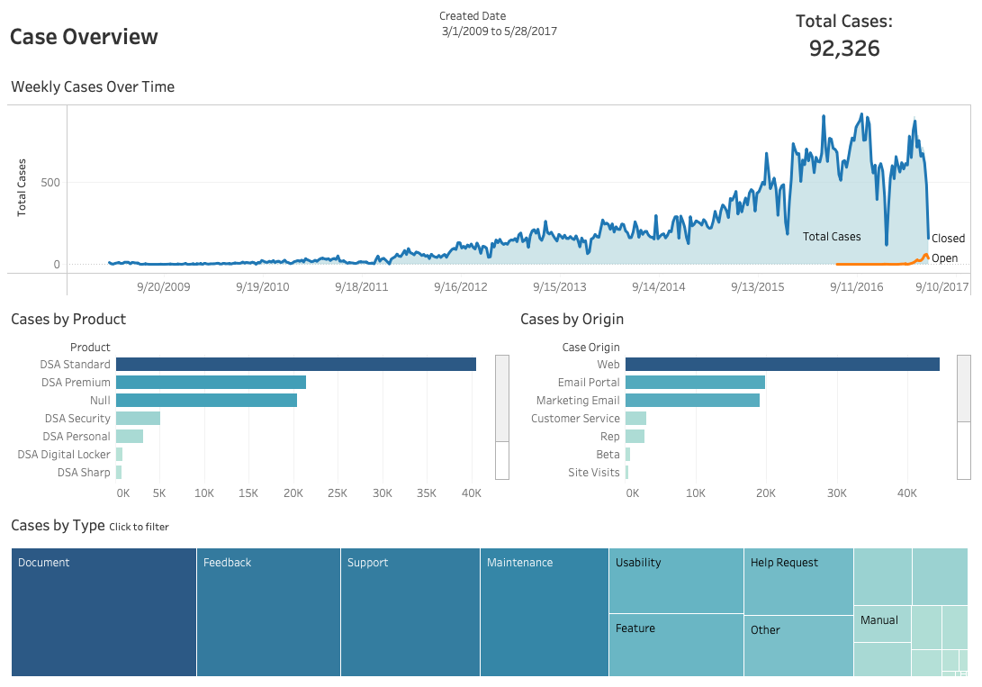

Slide 3
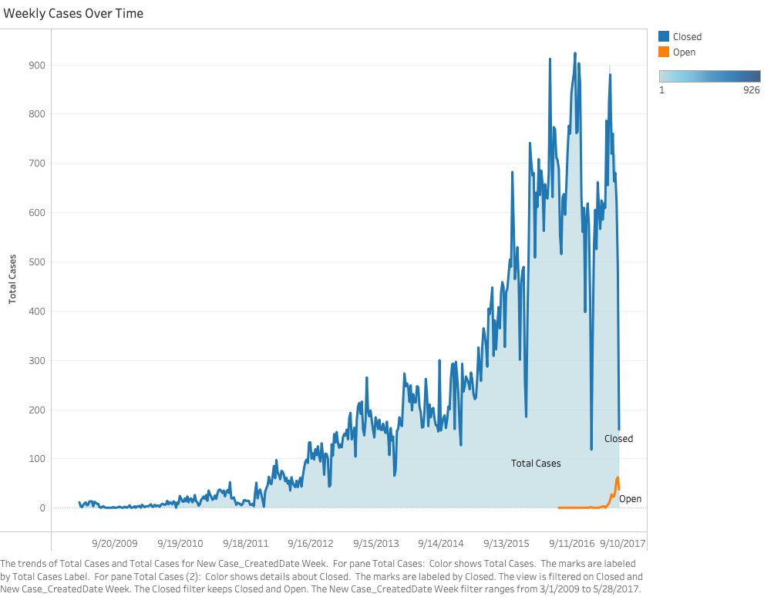

Slide 4
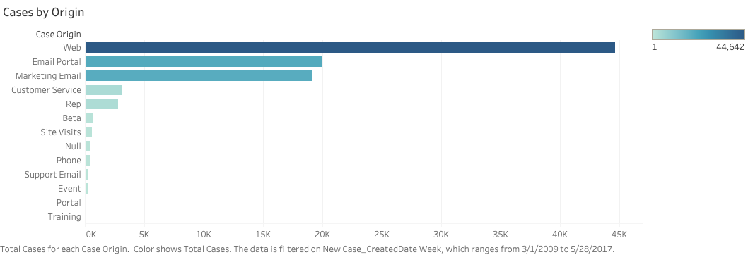

Slide 5


Slide 6
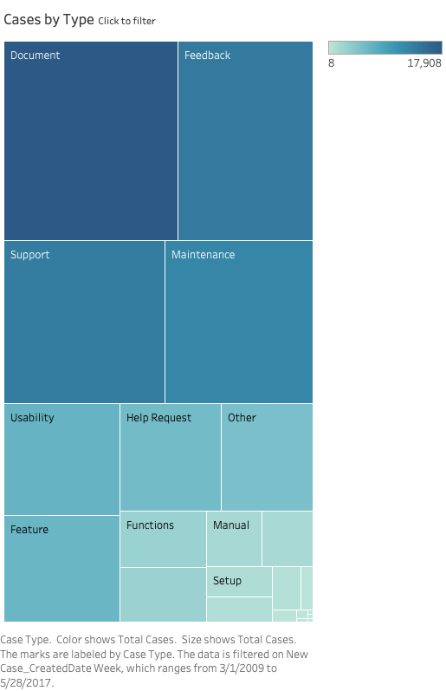

Slide 7


